Slide 1


TeamItaly CTF 2022
Challenge: Ik1VM - CrackmeEVA
Category: rev
Author: Armando Bellante <ikiga1>

Slide 2


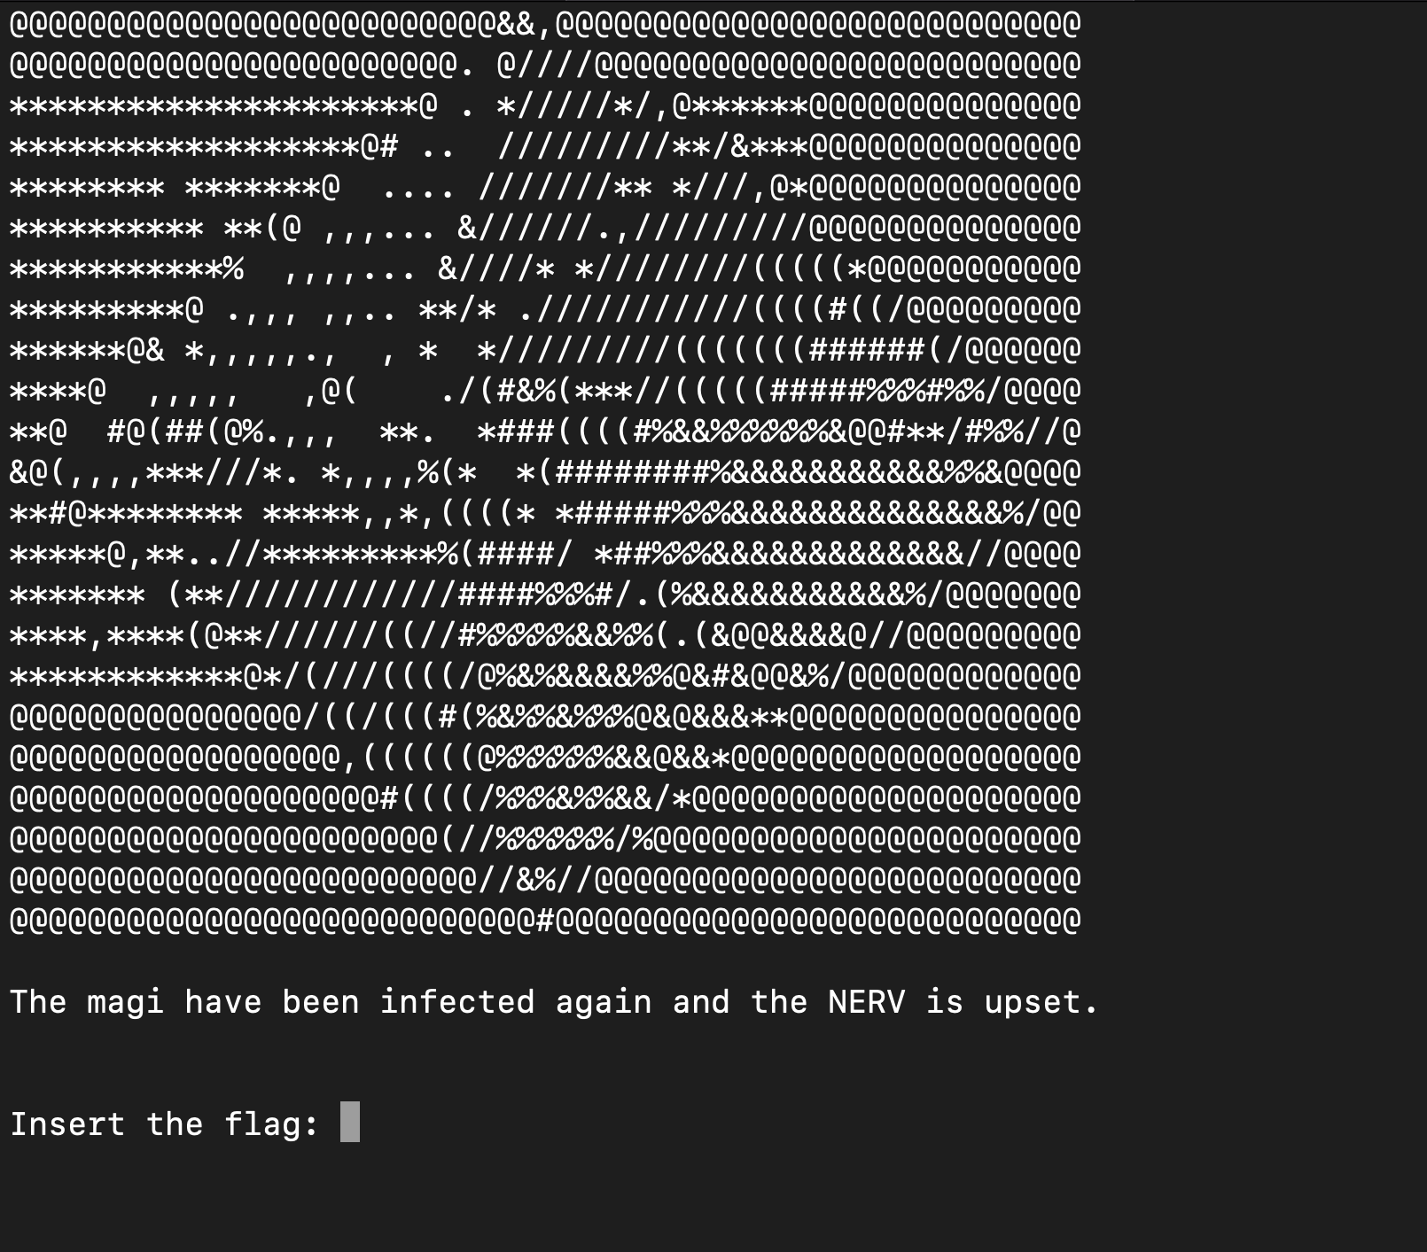
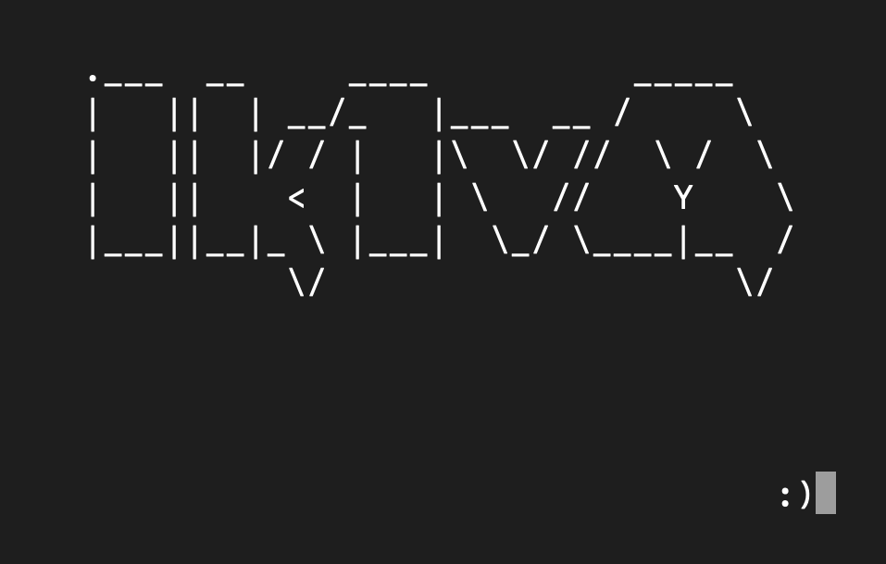

Ik1VM - CrackmeEVA
./emulator
./crackme_eva.ik1vm

Slide 3
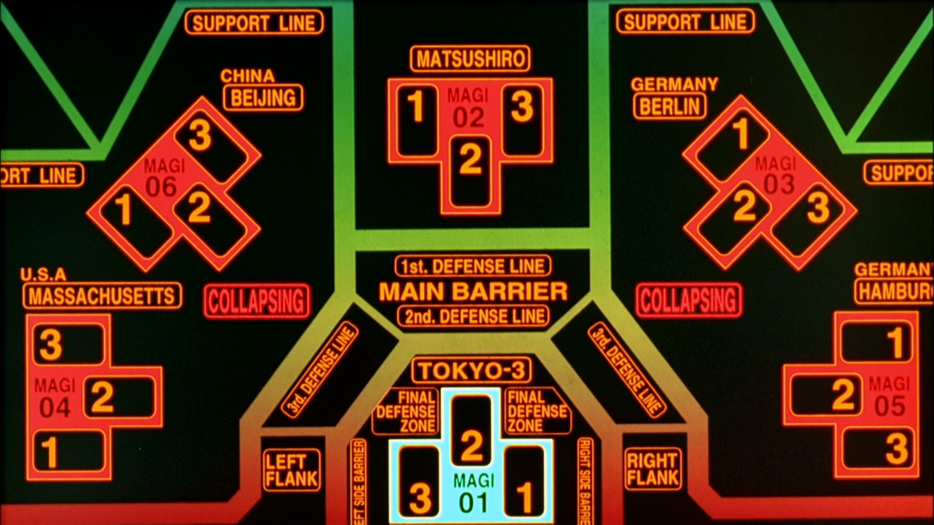
Ik1VM - CrackmeEVA
Magi system

Slide 4
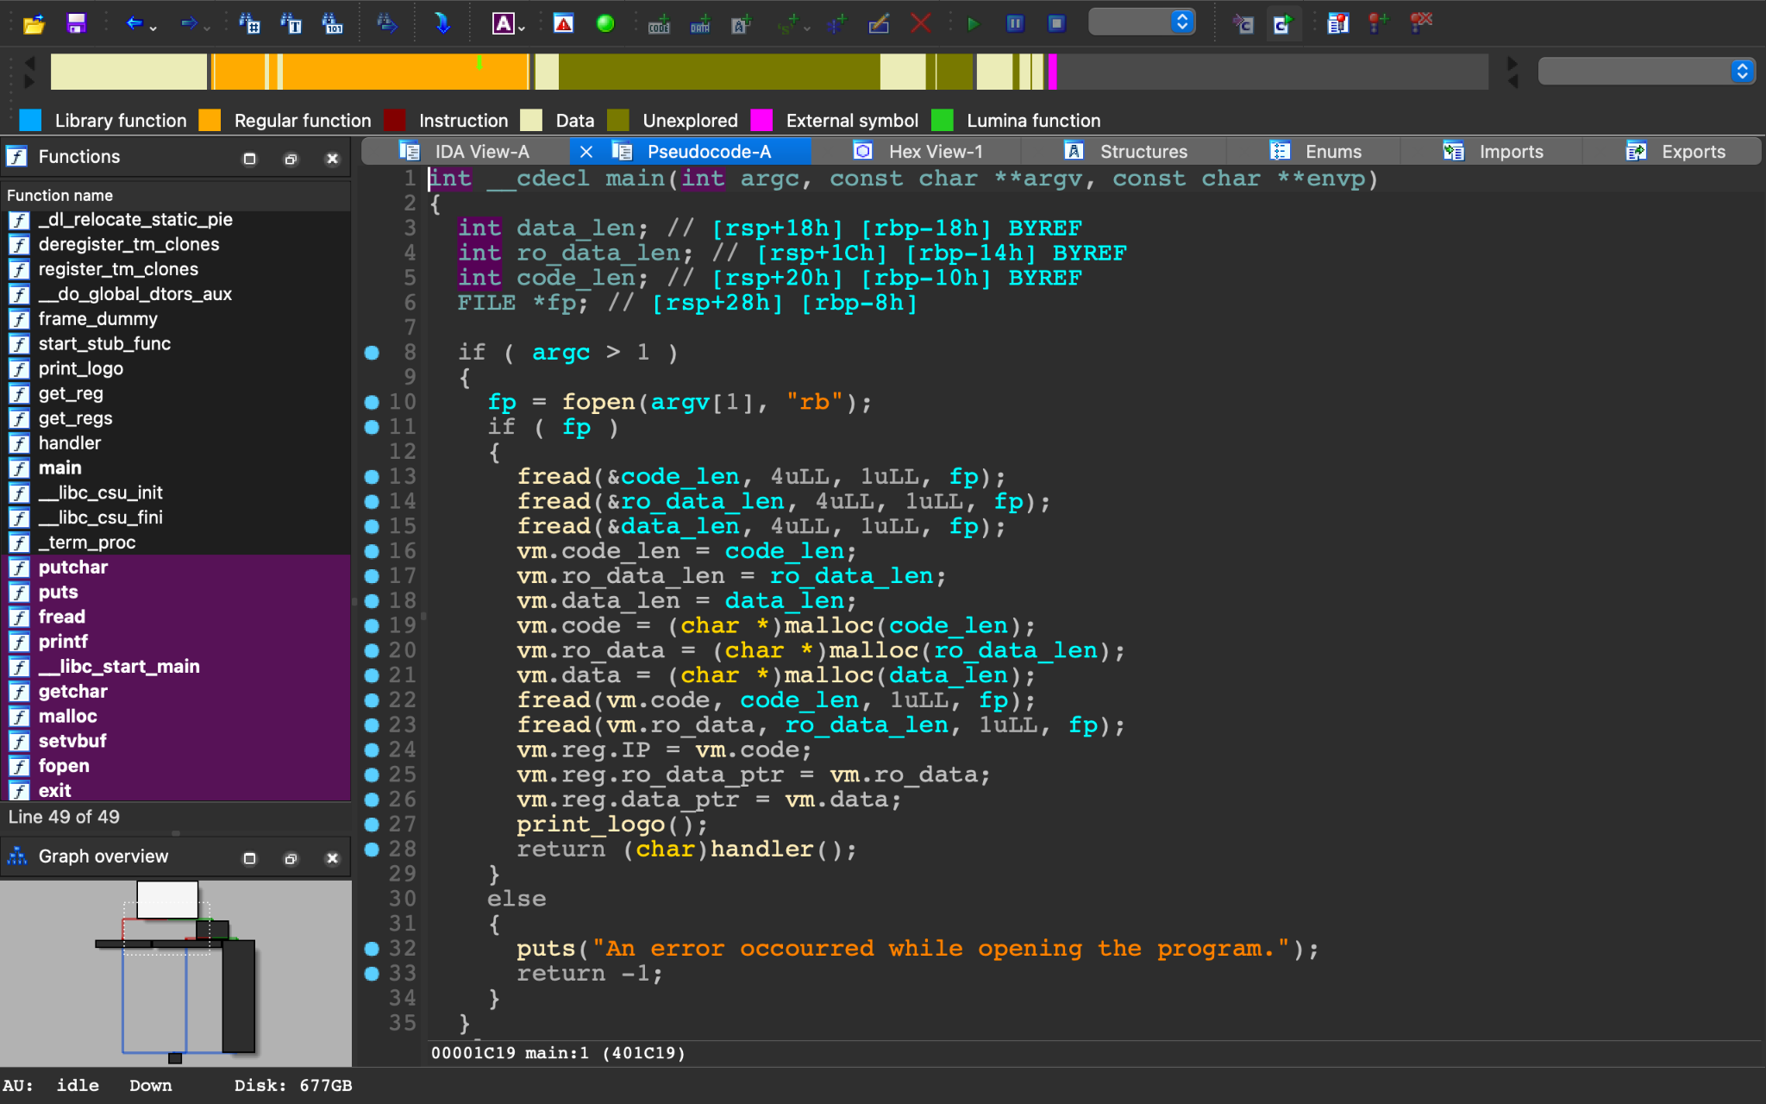
Load Ik1VM on a decompiler… no strip

Slide 5
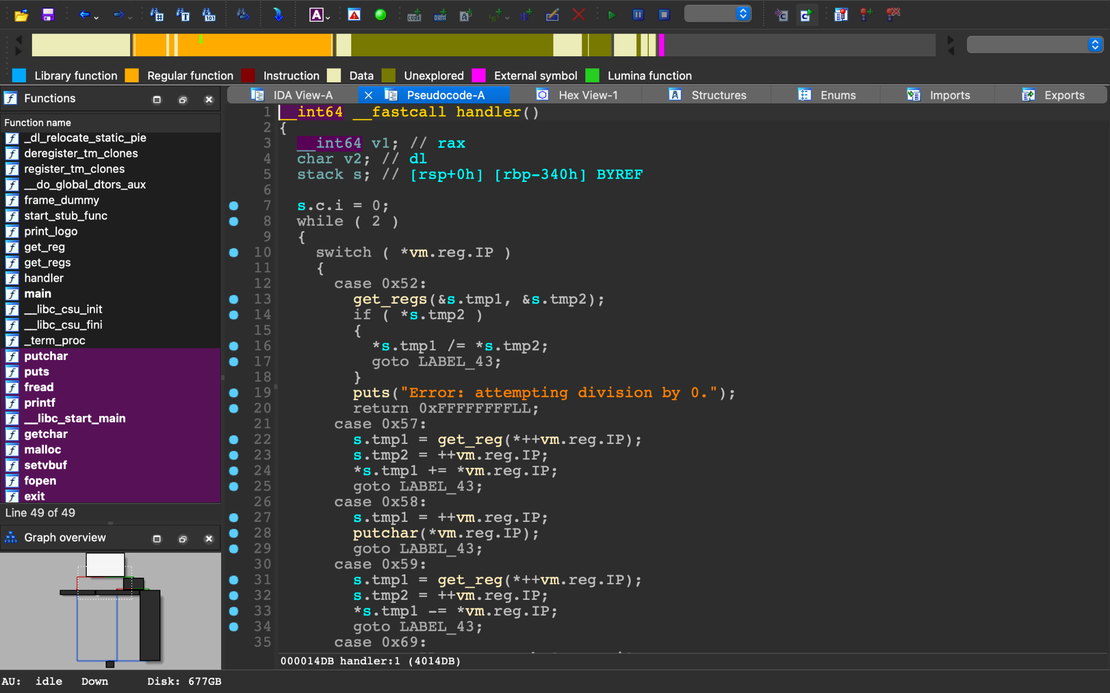
Load Ik1VM on a decompiler… no strip

Slide 6
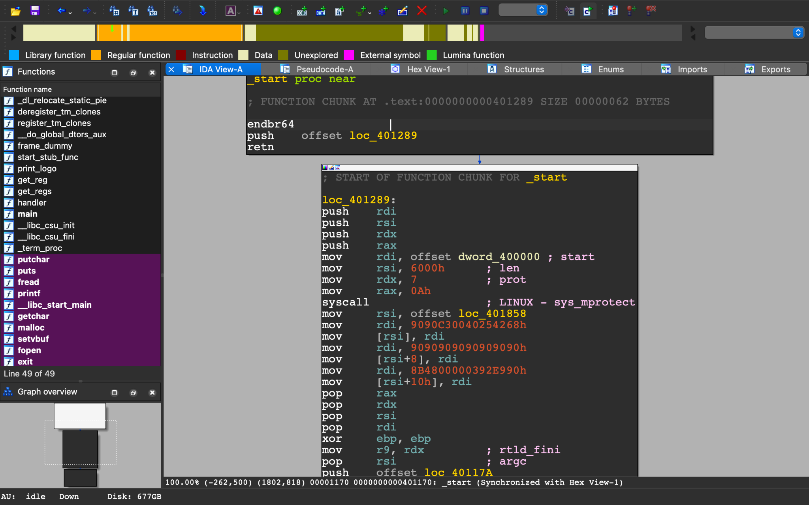
Afterall the missing strip won’t be an issue:
Ik1VM _start

Slide 7
Intro - CrackmeEVA
inside vm.code (heap)
print Angel asciiart
copy 24 bytes from ro_data to data
Get flag. Store in data
Division by 0
…
check vm.reg.flag
…

Slide 8
Intro - CrackmeEVA
inside vm.code (heap)
Division by 0
…
check vm.reg.flag
…
inside char * evildata (Ik1VM)
Triggers antidebugging check. (patch in start)

Slide 9
Antidebugging check - Ik1VM
inside char * evildata
push regs
Decrypt antidebugging code
check enc. PTRACE_BLOCK
Check if any /proc/PID/status is gdb
Check PTRACE
Check 0xCC in handler
set vm.reg.flag=1
Destroy backdoor code
mprotect vm’s heap page
restore regs
jmp back
Encrypted

Slide 10
Defeating antidebugging
Some ways:
automate the debugging to set $rax=1 after call to ptrace
do not set breakpoints inside handler, do it after the antidebugging check or change the number of 0xcc in rbx to the correct number while debugging.
`mv gdb asd` will change the program name and make the debugger undetected

Slide 11
Antidebugging check - CrackmeEVA
inside vm.code (heap)
Division by 0
antidebug - ik1vm
check vm.reg.flag
control flag format
flag{...}
…
…
call +1
x103
“Oh no...We better get ready for another impact.”
“Not even the flag format...?”
code we cannot disassemble…
(return?)

Slide 12
What’s next?
inside vm.code (heap)
Division by 0
antidebug - ik1vm
check vm.reg.flag
??
control flag format
flag{...}
…
…
call +1
x103
“Oh no...We better get ready for another impact.”
“Not even the flag format...?”
code we cannot disassemble…
(return?)

Slide 13
The weird calls - CrackmeEVA
Cache
…
…
call +1
…
…
call +1
…
…
call +1
…
handler_RetADD
code we cannot disassemble…
(return?)

Slide 14
The weird calls - CrackmeEVA
Cache
…
…
call +1
…
…
call +1
…
…
call +1
…
addr1:
addr1
handler_RetADD
code we cannot disassemble…
(return?)

Slide 15
The weird calls - CrackmeEVA
Cache
…
…
call +1
…
…
call +1
…
…
call +1
…
addr1:
addr1
addr2:
addr2
handler_RetADD
code we cannot disassemble…
(return?)

Slide 16
The weird calls - CrackmeEVA
Cache
BUFFER OVERFLOW!
…
…
call +1
…
…
call +1
…
…
call +1
…
addr1:
addr1
addr2:
addr2
addr_final
addr_final:
code we cannot disassemble…
(return?)

Slide 17
The weird calls - CrackmeEVA
Cache
…
…
call +1
…
…
call +1
…
…
call +1
…
addr1:
addr1
addr2:
Invaild IP
addr2
x86/64 code!
(mprotected)
handler:
ret
addr_final
addr_final:
code we cannot disassemble…
(return?)

Slide 18
Backdoor activation - Ik1VM + CracmeEVA
inside char * evildata
code we cannot disassemble…
(return?)
==
inside vm.code (heap)
backdoor_addr:
load offset, key, len from data
mov rax, 0x71a177
xor eax, 0x71a177^backdoor_addr
push rax
ret
decrypt ro_data+offset
jmp ro_data+offset
inside vm.ro_data (heap)
encrypted
True flag check
x86/64

Slide 19
True flag check - CracmeEVA
inside vm.ro_data (heap)
True flag check
x86/64
The assembly checks the flag format and then the flag content
The flag is hidden in some bits of the following string:
'fKfcmxnbfKfKnF$onF$omxnFnQnbnb$onSnQmxfK$onbfKnFfKnQnF$onQnFnbmx'

Slide 20
Solving the chall
1. Reverse the true check and automate debugging tools (e.g., a gdbinit) to dump the bits that reconstruct the flag.
2. Reverse the true check and write the inverse check function (static approach).
3. Extract the x86-64 code, create a binary with it and run angr on it.
4. Setup angr to solve it directly.

